Slide 1
19 September 2018
Discuss Ancient Middle East Civilizations Timeline
The Ancient Hebrews and the Origins of Judaism Cornell Notes
Objectives: Describe ancient civilizations of ME to determine its impact on the region; identify basic beliefs and holy text of Judaism.

Slide 2
The Ancient Hebrews and the Origins of Judaism
Objectives: Describe the origins of Judaism, including key people, figures, events and concepts; Summarize the history and beliefs of the ancient Hebrews
EQ: What were the origins of the Jewish Faith?

Slide 3
Who were the Hebrews?
The Hebrews were a group of people who lived northeast of Egypt.
The Hebrew civilization developed gradually after 1800 B.C.E. and flourished until 70 C.E.
The people who became Hebrews originally lived in Mesopotamia.
Around 1800 B.C.E., they moved to the land of Canaan (modern day Israel)
Canaan
Mesopotamia

Slide 4
Who were the Hebrews?
The Hebrews were the founders of Judaism
Judaism: one of the world’s major religions
The Hebrews eventually became known as the Jews.
Judaism is the Jewish religion.

Slide 5
What is the Torah?
The Torah contains the basic laws of Judaism and tells many stories about the history of the Hebrew people.
The Torah is the Jewish Bible (also known by Christians as the Old Testament)
The word Torah means “God’s teaching.”

Slide 6
What is the Torah?
Historians use the stories told in the Torah to understand the history of the Hebrews and the development of Judaism.
It is important to remember that the Hebrews wrote their stories to explain and celebrate their beliefs.
Although many people believe that the Torah is a true record of the times, most historians combine the information there with other kinds of evidence, such as archeological artifacts and other written records, to understand the events and ideas of that time period.

Slide 7
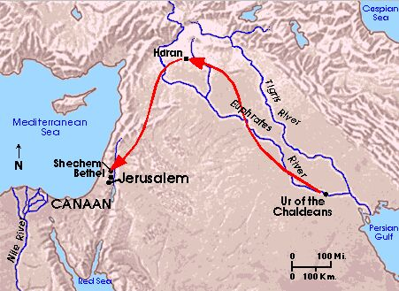
The Early History of the Hebrews
According to the Torah, the ancestor of the Hebrews, a man named Abraham, lived near Ur in Mesopotamia.
Around 1800 B.C.E., Abraham and his clan migrated to the land of Canaan.
In the land of Canaan, the Hebrews became nomads who herded flocks of sheep and goats.

Slide 8
The Early History of the Hebrews
About 1650 B.C.E., many Hebrews moved to Egypt.
According to the first book of the Torah, Genesis, they fled Canaan because of drought and threat of famine.
EGYPT

Slide 9
The Early History of the Hebrews
Carefully read and annotate the article “What do Jews Believe?”
Highlight/Underline Main Ideas/Beliefs regarding the Jewish Faith
Complete the Key Concept Synthesis Chart
Objectives: Identify and summarize key concepts of the Jewish faith

Slide 10
The Early History of the Hebrews
Read and annotate “The Call of Abraham”
Answer the question: Why is “The Call of Abraham” significant to the Jewish faith?
Read “Ancient Hebrews: Abraham and the Covenant” > Annotate the covenant > Complete the Chart > Discussion > Submit
HOMEWORK: Read & Annotate “Origins of the Jews as God’s Chosen People” > Complete the Key Concepts Synthesis Assignment
Objectives: Describe the origins of Judaism, including key people, figures, events and concepts; Summarize the history and beliefs of the ancient Hebrews

Slide 11
The Ancient Hebrews and the Origins of Judaism
Continue to read and annotate “What do Jews Believe?”
Complete the Key Concept Synthesis Chart
Share your Key Concepts with a peer
Judaism Cornell Notes (cont’d)
Objectives: Describe the origins of Judaism, including key people, figures, events and concepts; Summarize the history and beliefs of the ancient Hebrews

Slide 12
Important Hebrew Leaders
Abraham
The “father of the Hebrews”
According to the Torah, Abraham introduced the belief in “one God” (monotheism) to the Hebrews.
This was a new idea in the ancient world.
At the time, most people practiced polytheism
Led the Hebrews from Mesopotamia to Canaan.
According to the Torah, God promised to make Abraham the father of a great nation and bless his people if he would take the Hebrews to Canaan.
As a result, many Jews consider themselves to be God’s “chosen people.”

Slide 13
The Early History of the Hebrews
For a time, they prospered in Egypt, but eventually they were made slaves.
In time, one of their leaders, Moses, led the Hebrews in their escape from Egypt.
- For 40 years, says the Torah, the Hebrews wandered in the wilderness, until they settled once again in Canaan.

Slide 14
Important Hebrew Leaders
Moses
The greatest leader of the Hebrews
According to the Torah, Moses led his people out of slavery in Egypt - Exodus
Moses told the Hebrews that God would lead them to Canaan, the “promised land,” in exchange for their faithful obedience.
Moses also gave Judaism its fundamental laws.
The Torah tells how God gave Moses 10 important laws engraved on two stone tablets –Ten Commandments
These laws became the foundation of Judaism.

Slide 15
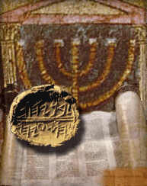
24 September 2018
Cornell Notes > The Time of Judges, Kings, and Prophets
“The Rise and Fall of the Hebrew Kingdom” Timeline Assignment
“The Hebrews & Judaism – Result of the Revolt” Cause & Effect Assignment
EQ: What was the Time of Judges & Kings?
Objectives: Describe the origins of Judaism, including key people, figures, events and concepts; Summarize the history and beliefs of the ancient Hebrews

Slide 16
Settling the Land
Moses died before arrival at Canaan --> successor, Joshua, led Israelites
For 200 years = Israelites fought the Philistines for control of the land
Lack of unity among the 12 tribes made fighting difficult
Continued warfare led tribes to unite under 1 king = Saul
Saul couldn’t help them defeat Philistines & David took the throne

Slide 17
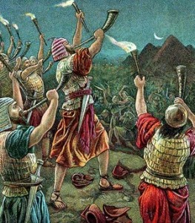
The Time of Judges, Kings, and Prophets
Remember the Hebrews lived a nomadic life for 40 years before finally reaching the land of Canaan.
Their arrival marks the beginning of the time described in the Bible as the period of “Judges and Kings”.
Judges = charismatic and influential tribe leaders
The Judges helped the Hebrews form a sense of identity.
Eventually the Hebrews longed for a king to lead them.

Slide 18
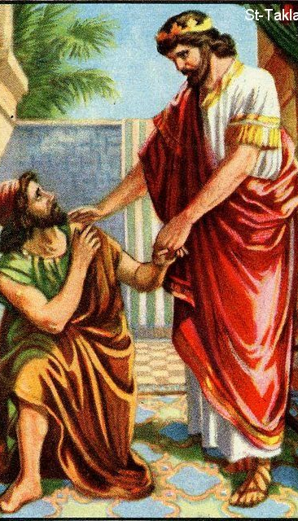
The Time of Judges, Kings, and Prophets
Eventually the Hebrews longed for a king to lead them.
God granted them a king; first Saul, then David.
David was a great king who won many military battles and established Jerusalem as his capital city.
David’s son Solomon built a temple that would come to be the centre of worship for Jewish faith for the next 1000 years.
Eventually, the Hebrew tribes split, and the northern tribes’ land took on the name “Israel”.

Slide 19
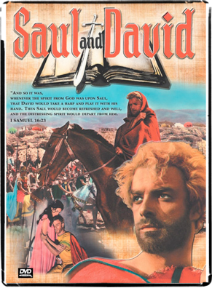
The Time of Judges, Kings, and Prophets
Monotheism separated Israelites from other regional groups
Traded with other groups, but did not adopt cultures or beliefs
Philistines invaded and conquered Israelite territory around 1029 B.C.E.
Israelites agreed to unite under one king to fight the Philistines
Israelites had feared a king having too much power

Slide 20
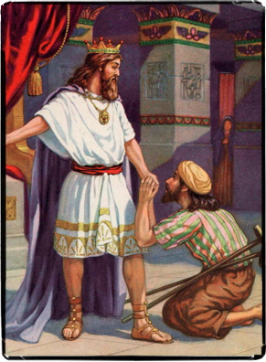
The Time of Judges, Kings, and Prophets
First king, Saul, successfully fought the Philistines around 1020 B.C.E.
Bible says that after Saul’s death, they chose his son-in-law, David, as king
David’s army drove out the Philistines
Won back Jerusalem
Became very important capital city of the Israelites

Slide 21
The Time of Judges, Kings, and Prophets
Solomon was chosen to succeed his father, David, in a new line of kings (dynasty)
Became king around 962 B.C.E.
Ruled wisely over a strong nation
Built up trade with the Phoenicians
Built important Temple in Jerusalem
Became known as Solomon’s Temple
Meant to be permanent home of the Ark of the Covenant
Required high taxes to pay for build
Also required men to give a third of their time to help build

Slide 22
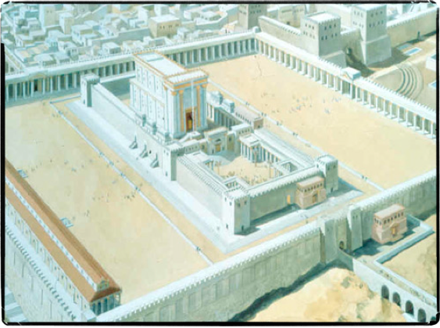
Solomon’s Temple
Jerusalem
Built in c. 9th Century B.C.E.
Destroyed in 587 B.C.E.
Rebuilt in 516 B.C.E.
Destroyed again in 70 C.E.

Slide 23
Now
Summarize Cornell Notes re: Time of Judges & Kings” > Share
Carefully read and annotate “The Rise and Fall of the Hebrew Kingdom” > Complete the Timeline
Should you finish, read “The Hebrews & Judaism – Result of the Revolt” > Complete Cause and Effect Chart
Submit Your Work
Objectives: Describe the origins of Judaism, including key people, figures, events and concepts; Summarize the history and beliefs of the ancient Hebrews

Slide 24
The Kingdom Divides
Complete Timeline > Cornell Notes
Essential Question:
What was the outcome of the conflict among the Israelites?
Objectives: Describe key people, figures, events and concepts; Summarize the history and beliefs of the ancient Hebrews

Slide 25
Israel and Judah
Solomon died in 922 B.C.E.
Succeeded by son who faced rebellion
Northern tribes demanded less taxes, and an end to forced labor
Kingdom split into northern Israel and southern Judah
Judah included the city of Jerusalem
Words Judaism and Jews came from the name Judah
Two kingdoms lasted about 200 years

Slide 26
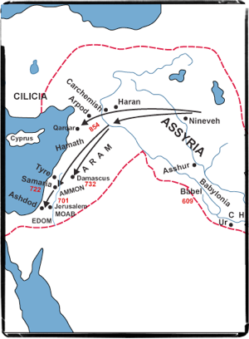
Assyrians and Babylonians Strike Review your Timeline – Significance?
By 738 B.C.E., Assyrians were forcing both kingdoms to pay tribute
Assyria conquered and ended the Kingdom of Israel in 722 B.C.E.
Assyrian Empire fell by 609 B.C.E.
Large parts of empire conquered by the Babylonians around 612 B.C.E.
Babylonia’s King Nebuchadnezzar captured Jerusalem in 586 B.C.E.
Babylonians destroyed Solomon’s Temple
Took thousands of enslaved Jews to Babylon

Slide 27
Jewish Exiles Return to Judah
Essential Question:
What hope sustained the Jews during the Babylonian exile?

Slide 28
Beliefs During the Babylonian Captivity
Exiles from Judah were in Babylon about 50 years – Babylonian Captivity
Israelite exiles became known as Jews
Kept religious traditions
Observed religious laws, holidays, worship
Israelites hoped to return to Judah and rebuild Temple in Jerusalem
Kept hoping for their own king, an heir to David’s throne – Messiah – “anointed one”
Jews sought spiritual leaders’ advice in troubled times
Believed some leaders, prophets, could interpret God’s word
Prophets warned people and rulers about straying from God’s laws

Slide 29
Beliefs During the Babylonian Captivity
The word Messiah is a Hebrew word which means “anointed one.”
Jews believe that the Messiah will
be a human being
a descendant of King David, who will
bring the world to a time of complete peace in which
every person will recognize and worship one God.
Expectation of the coming of a Messiah arose in Jewish tradition especially during and after the Babylonian Exile.

Slide 30
Who conquered the Babylonians…Significance?
Persians conquered Babylonia in 539 B.C.E.
Practiced religious tolerance
Persian king Cyrus the Great freed the Jewish exiles and allowed them to return to Judah
Jews rebuilt Solomon’s Temple in Jerusalem by 515 B.C.E.

Slide 31
Roman Control
Essential Question:
What was the result of Jewish resistance to Roman rule?

Slide 32
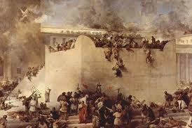
Rome Conquered Judea
Roman conquered Judah (Judea) in 63 B.C.E.
Roman rulers kept strict control over Judea
Jewish kings, and religious leaders were appointed by the Romans

Slide 33
Resistance to Roman Rule – How & Significance?
The Zealots, a Jewish group, led a rebellion against Rome in 66 C.E.
Roman general Vespasian was sent to stop uprising
In 70 C.E., Titus stopped rebellion and burned down the second temple
Some Jews fought on at Masada fortress, but it was taken

Slide 34
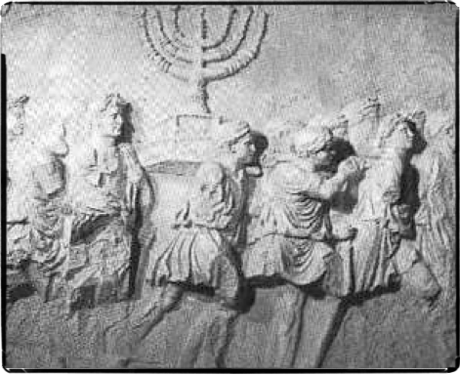
The Great Diaspora
Loss of Temple and Jerusalem caused many Jews to leave Judea
Movement of Jews into the rest of the world - the Diaspora; means scattered
Romans sent many Jews to Rome as slaves
Some Jews remained in Jerusalem

Slide 35
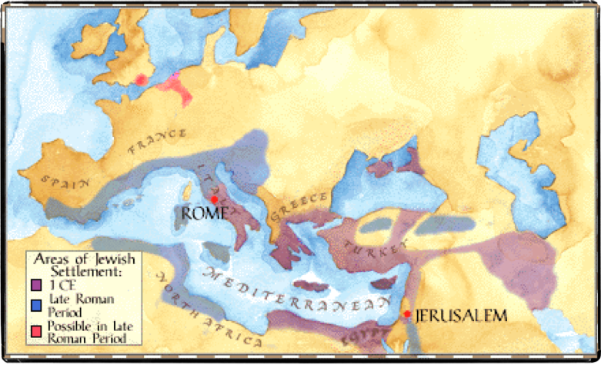

Slide 36
Teachers and the Law
Though scattered, many Jews kept their beliefs in righteousness and justice
Rabbis - religious teachers and leaders - kept Jewish identity as a people
Built synagogues, places of worship and prayer, wherever Jews settled
Read Torah and its interpretations to the Jews
Jews kept their faith, followed laws, observed customs, and studied Torah

Slide 37
26 SEPTEMBER 2018
REVIEW MENA MAP, CORNELL NOTES > REGIONS OF THE MIDDLE EAST, ANCIENT CIVILIZATIONS TIMELINE, CORNELL NOTES > JUDAISM
CREATE YOUR STUDY GUIDE
STUDY & PREPARE FOR ASSESSMENT
OBJECTIVE: Identify and summarize the major historical events of the ancient Middle East as well as Judaism

Slide 38
27 September 2018
History is a story! Are you able to tell someone else’s story effectively to represent who they are?
Write the story of the Hebrews & Judaism. Use specific historical details as you write the story.
Write Three Questions - one about Judaism, one about ancient and early Middle East Civilizations, one about the five regions of the Middle East
Share your stories and questions with your peers
OBJECTIVE: Identify and summarize the major historical events of the ancient Middle East as well as Judaism; Analyze and synthesize information from multiple sources

Slide 39
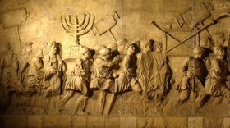
Now
Summarize Cornell Notes/Timeline info
Read “The Hebrews and Judaism – Result of the Revolt”
Complete the Cause and Effect Chart > Discuss
Objective: Identify the causes and effects of the Jewish Revolt in Rome

Slide 40
Important Hebrew Leaders
The ancient Hebrews told many stories about their leaders in the Torah.
Four key leaders were:
Abraham
Moses
David
Solomon
First, we will have a quick overview of who each of these men were and what makes them so important.
Then we will learn more about each of these four important leaders by looking at some of the stories from the Torah.

Slide 41
Important Hebrew Leaders
Abraham
The “father of the Hebrews”
According to the Torah, Abraham introduced the belief in “one God” (monotheism) to the Hebrews.
This was a new idea in the ancient world.
At the time, most people practiced polytheism
Led the Hebrews from Mesopotamia to Canaan.
According to the Torah, God promised to make Abraham the father of a great nation and bless his people if he would take the Hebrews to Canaan.
As a result, many Jews consider themselves to be God’s “chosen people.”

Slide 42
Important Hebrew Leaders
Moses
The greatest leader of the Hebrews
According to the Torah, Moses led his people out of slavery in Egypt.
Moses told the Hebrews that God would lead them to Canaan, the “promised land,” in exchange for their faithful obedience.
Moses also gave Judaism its fundamental laws.
The Torah tells how God gave Moses 10 important laws engraved on two stone tablets.
These laws became the foundation of Judaism.

