Slide 2
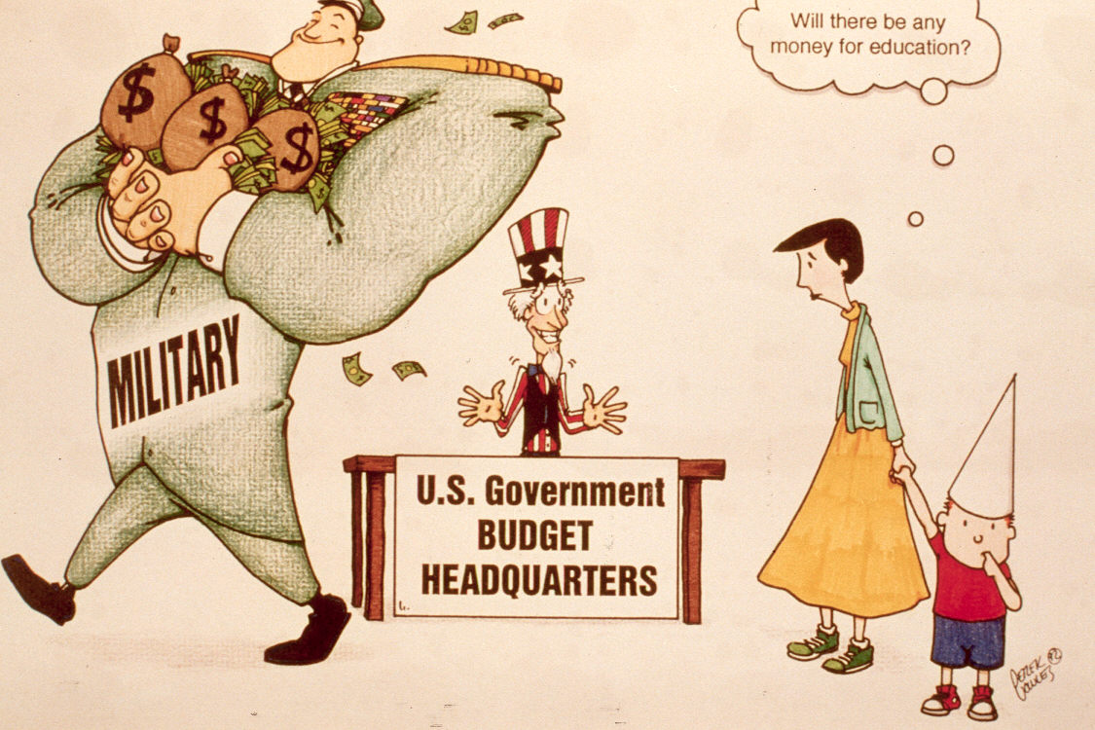
What details, symbols, actions, and words do you see in this political cartoon that make you think about what is happening?
1.3A

Slide 3
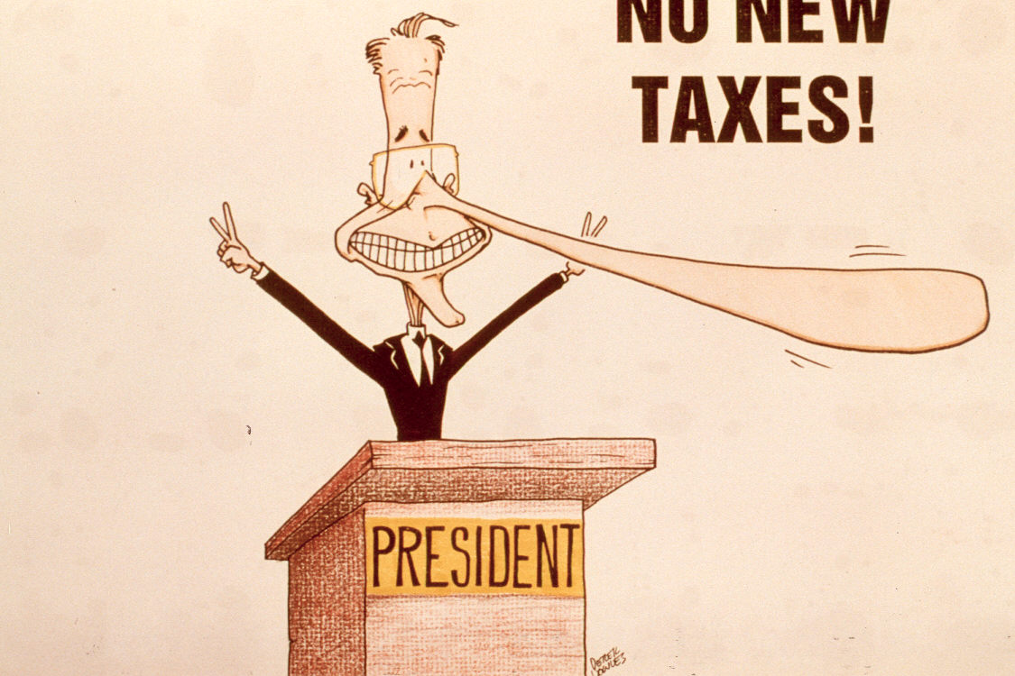
What details, symbols, actions, and words do you see in this political cartoon the make you think about what is happening?
1.3B

Slide 4
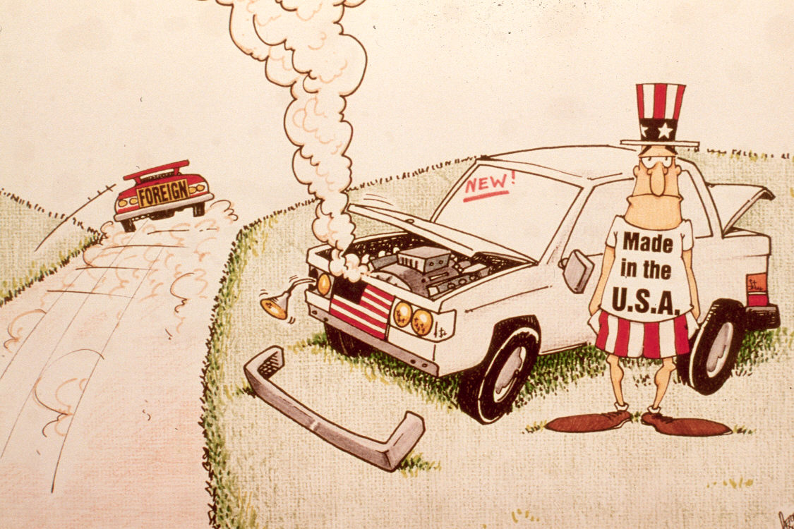
What details, symbols, actions, and words do you see in this political cartoon the make you think about what is happening?
1.3C

Slide 5
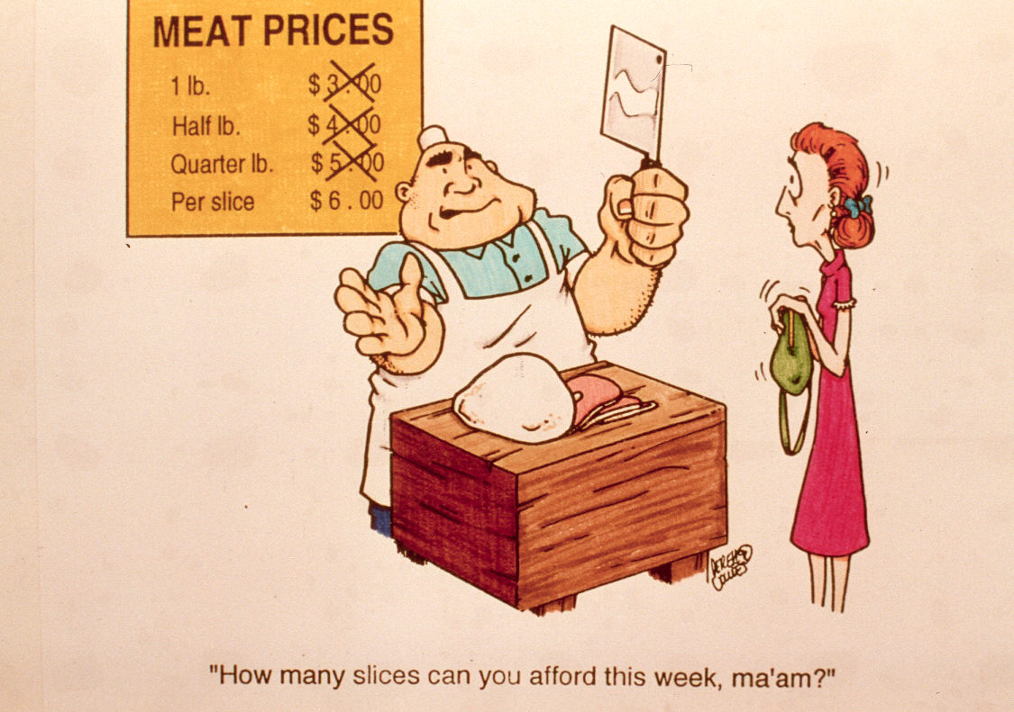
What details, symbols, actions, and words do you see in this political cartoon the make you think about what is happening?
1.3D

Slide 6
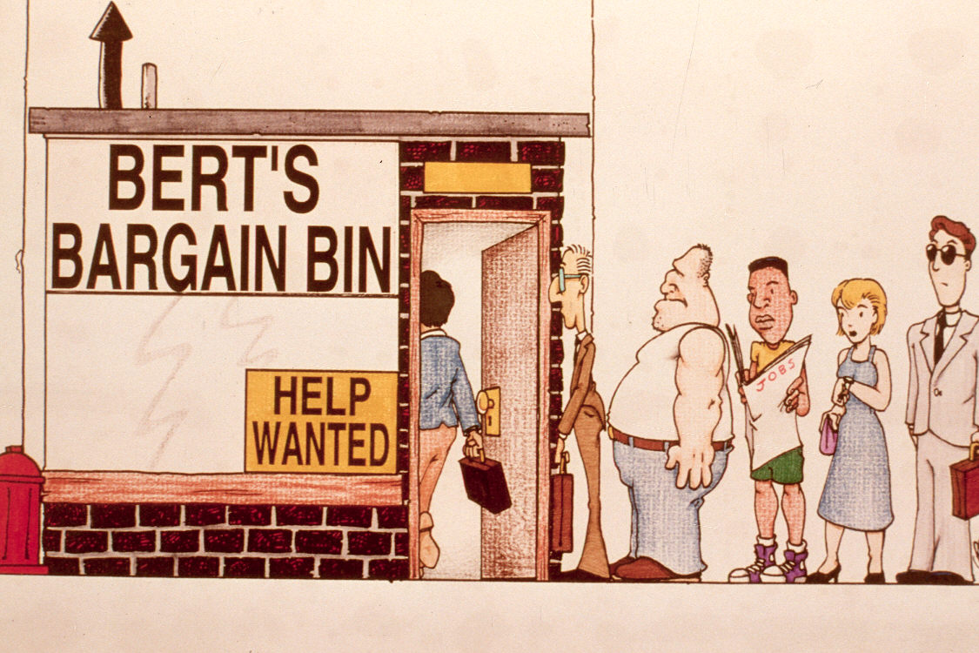
What details, symbols, actions, and words do you see in this political cartoon the make you think about what is happening?
1.3E

Slide 7
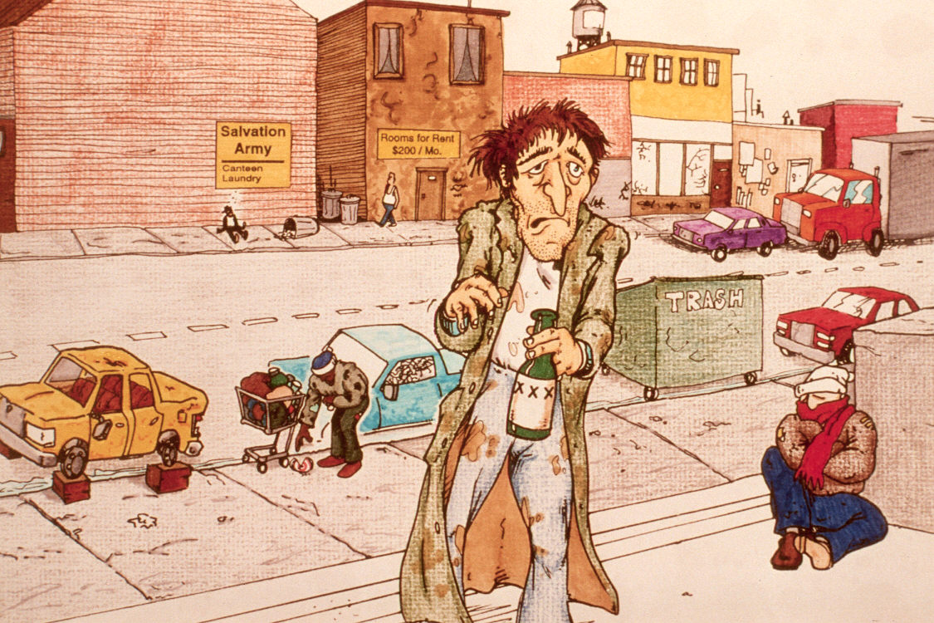
What details, symbols, actions, and words do you see in this political cartoon the make you think about what is happening?
1.3F

Slide 8
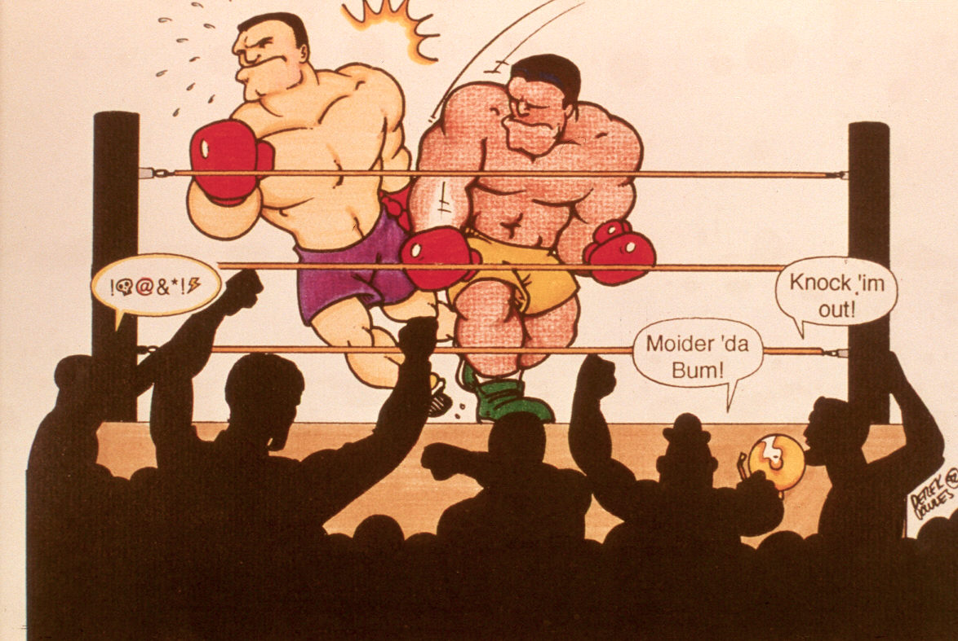
What details, symbols, actions, and words do you see in this political cartoon the make you think about what is happening?
1.3G

